Slide 1
AMINEF Midterm Presentation

Slide 2
Objectives
Determine the effect of mangrove restoration on the fishery production on Pulau Tanakeke, Takalar Regency, South Sulawesi Province, Indonesia.
Uncover what aspects of mangrove cover is most beneficial to juvenile fish populations (i.e. reductions in water temperature, shade, or increased plant biomass).

Slide 3
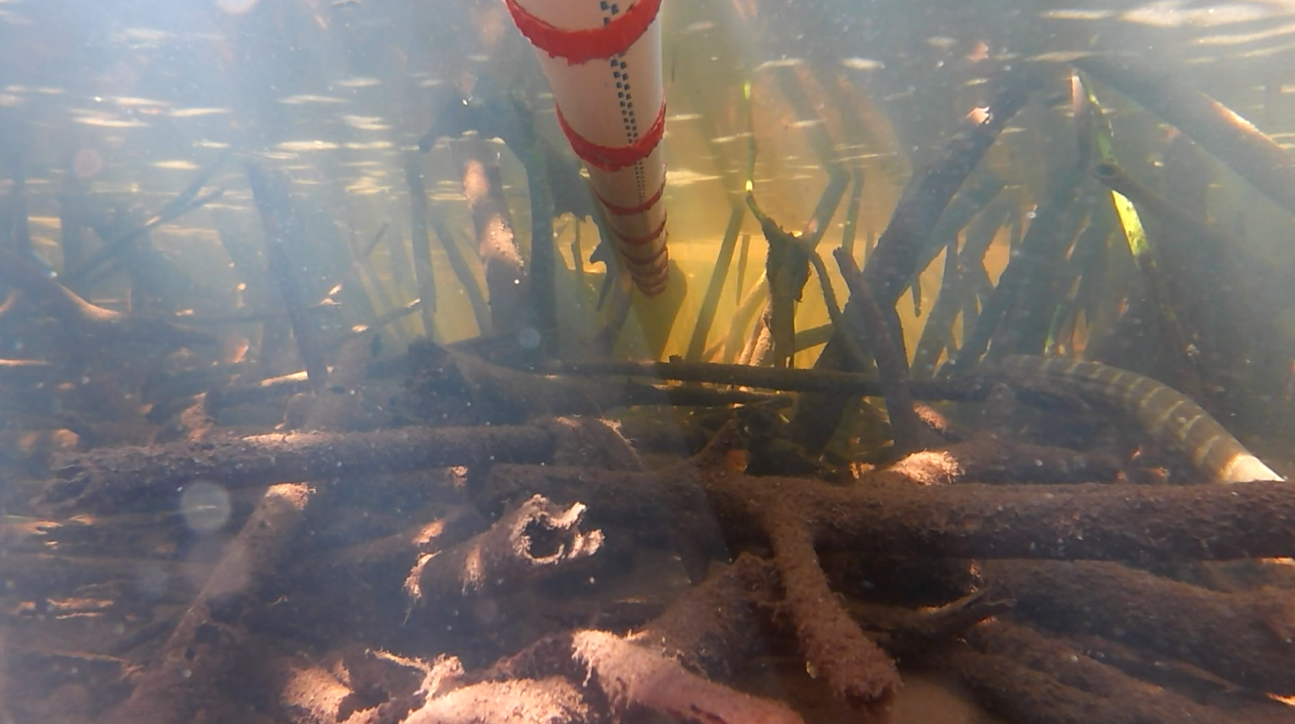
Methods
URUVS – Unbaited Remote Underwater Video
Non-invasive
Easy implementation

Slide 4

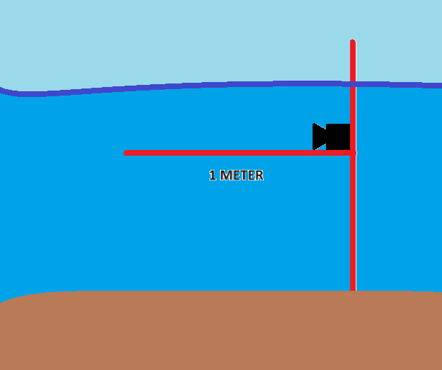
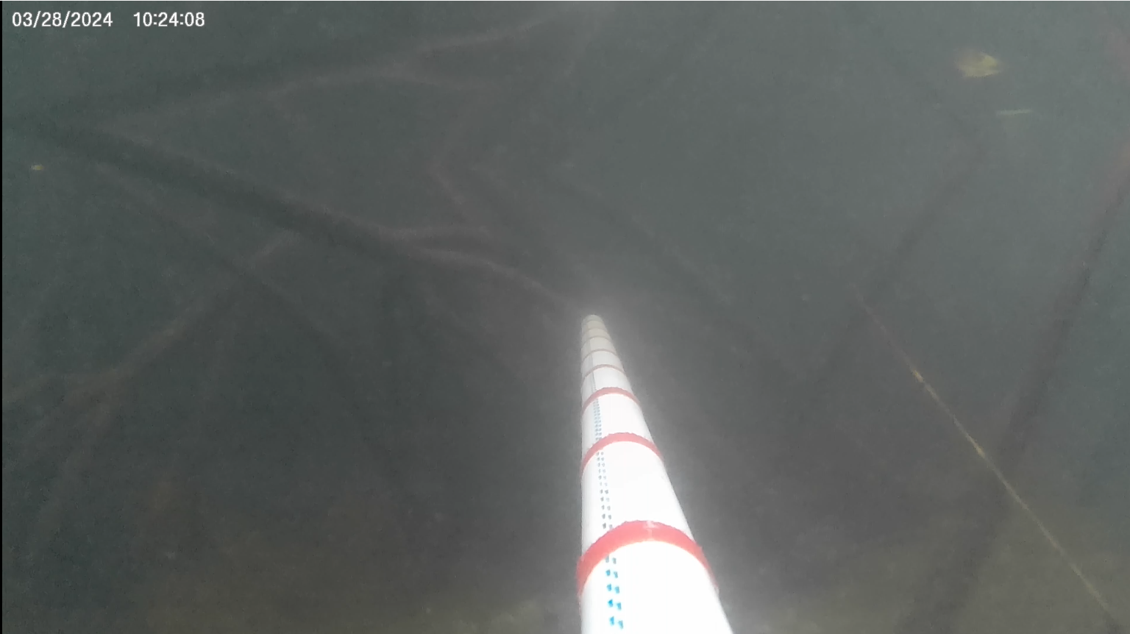
Setup – diagram and pic

Slide 5
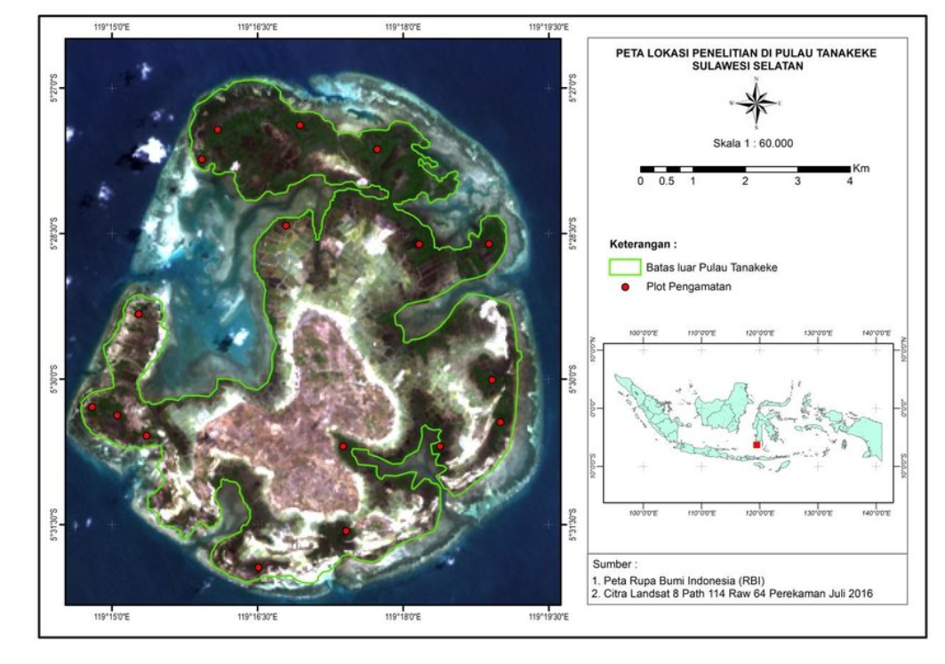
Pulau Tanakeke

Slide 6
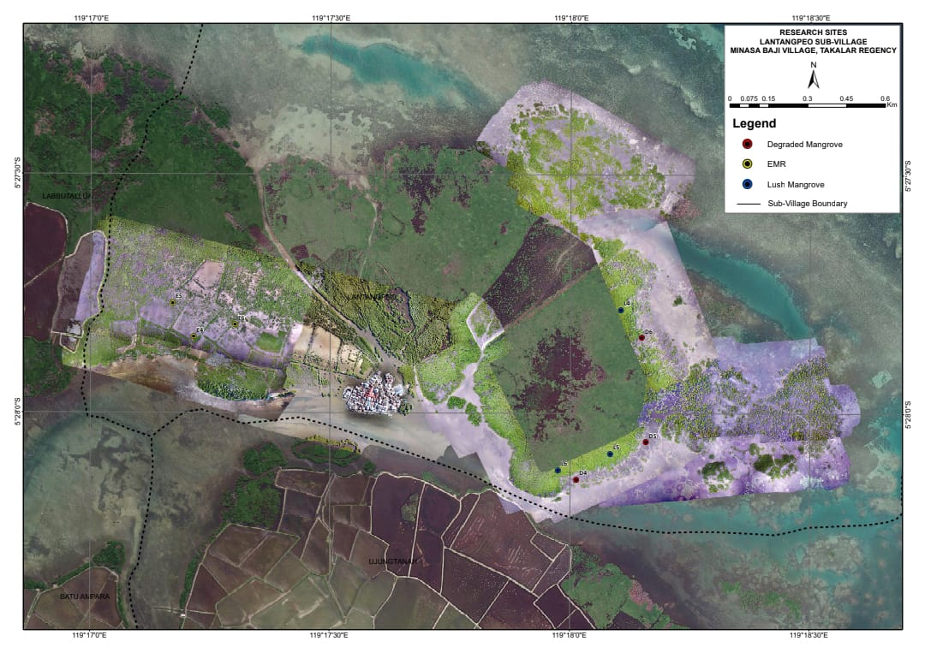
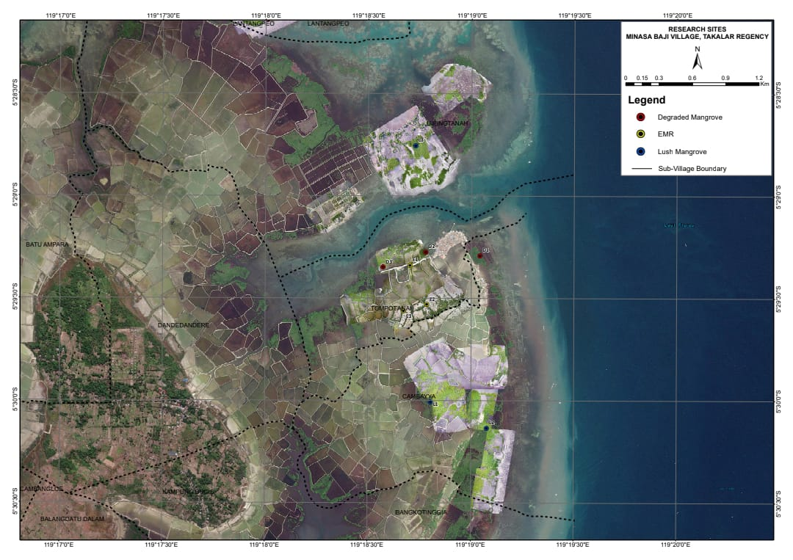
Sites
Latangpeo
Tompotana
EMR
NATURAL
DESTROYED

Slide 7
So far:
4 months of data collection (February - May)
18 videos per month
2 Desa – Tompotana and Lantangpeo
3 sites – destroyed mangroves (D)
3 sites – natural mangroves (L)
3 sites – restored mangroves (E)
All videos been watched (except half of April)
3 Temperature loggers in Lantangpeo (one in each of the mangrove types)

Slide 8
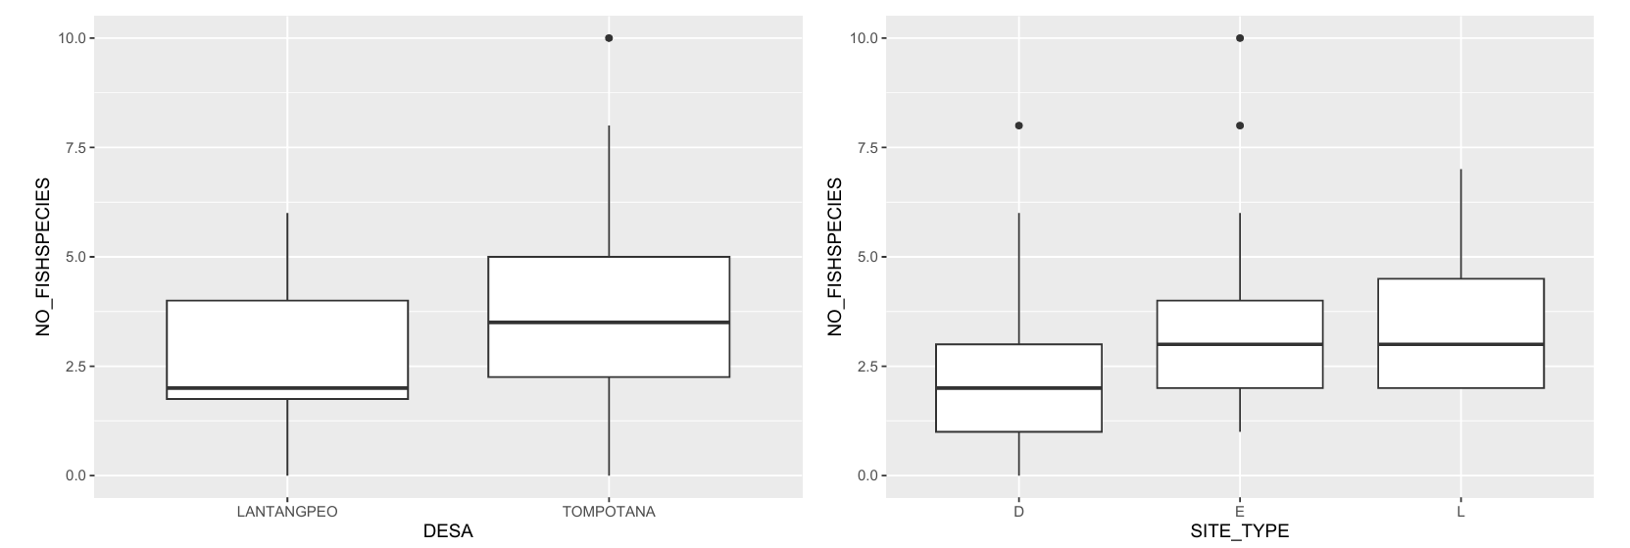
Preliminary Results – Total number of Species

Slide 9
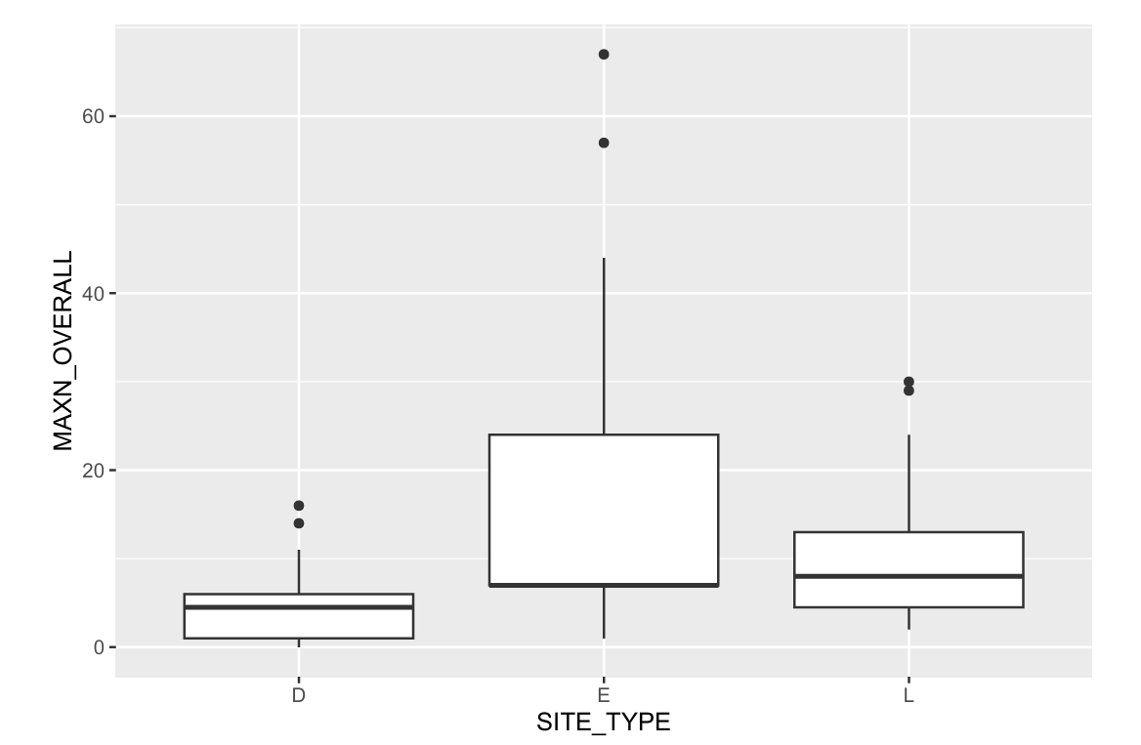
Preliminary Results – Total MaxN

Slide 10
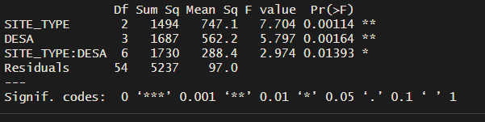
anova
Two-way ANOVA shows that both Mangrove type and Desa have a significant effect on the overall MaxN of the sites. These variables are also likely interacting, meaning that restoration in Latangpeo may have different effects than restorationin Tompotana

Slide 11
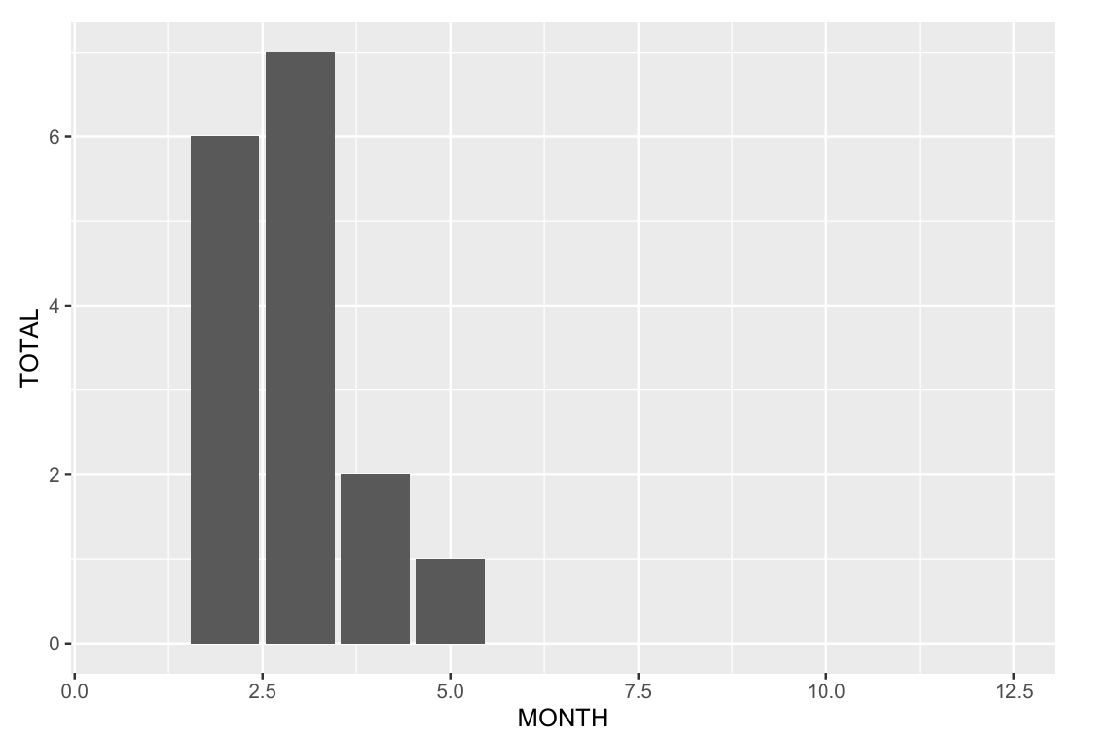
Temporal trends: Ikan Buntal

Slide 12
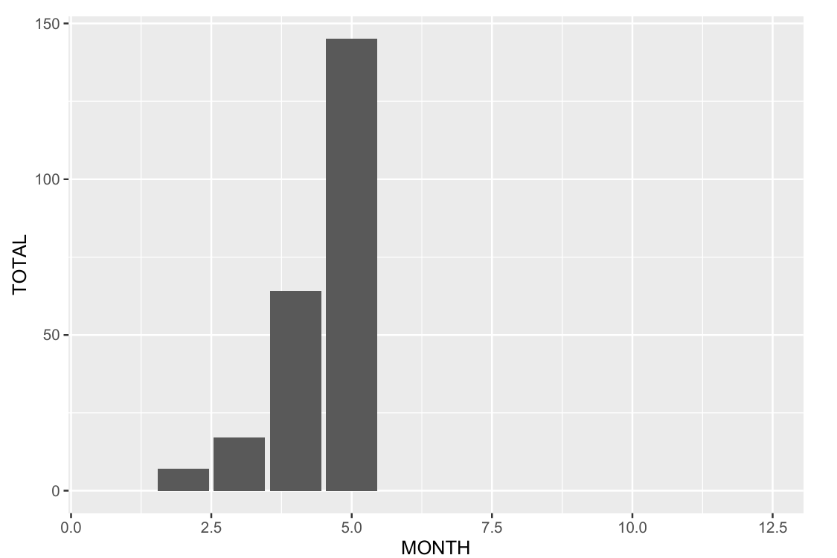
Temporal Trends: Cardinal Fish

Slide 13
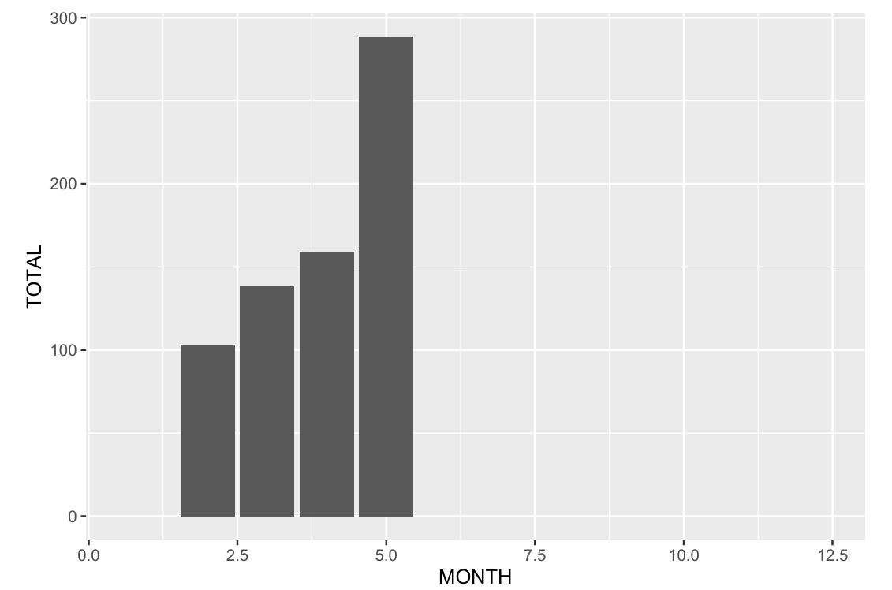
Temporal trends: Total Biodiversity

Slide 14
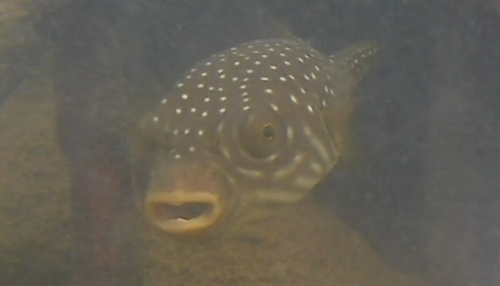
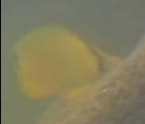

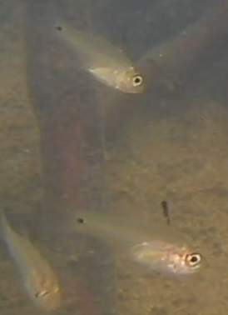
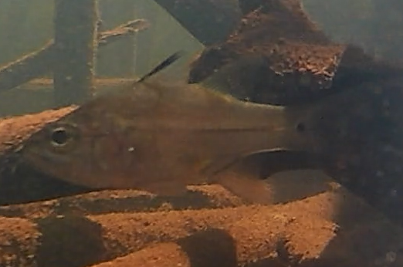
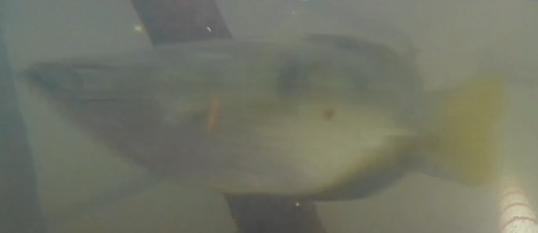
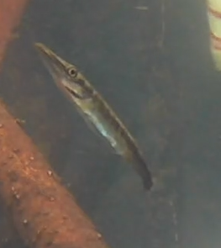
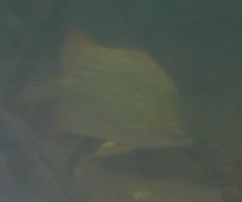
Species found
Reticulated Pufferfish -
Arothron reticularis
Yellow Longnose Butterfly Fish -
Forcipiger flavissimus
Cardinal fish – multiple species
Banded Archerfish - Toxotes jaculatrix
Spotted Butteryfly fish –
Scatophagus argus
baby barracuda - Sphyraenidae

Slide 15
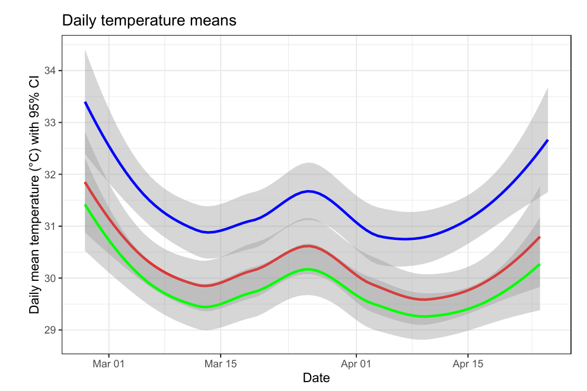
HOBO Results

Slide 16
Future Analyses
Temporal Trends
Shannon’s diversity Index
Principal Component Analysis
Community Structures
Connect data to canopy, weather, tides, and temperature

Slide 17
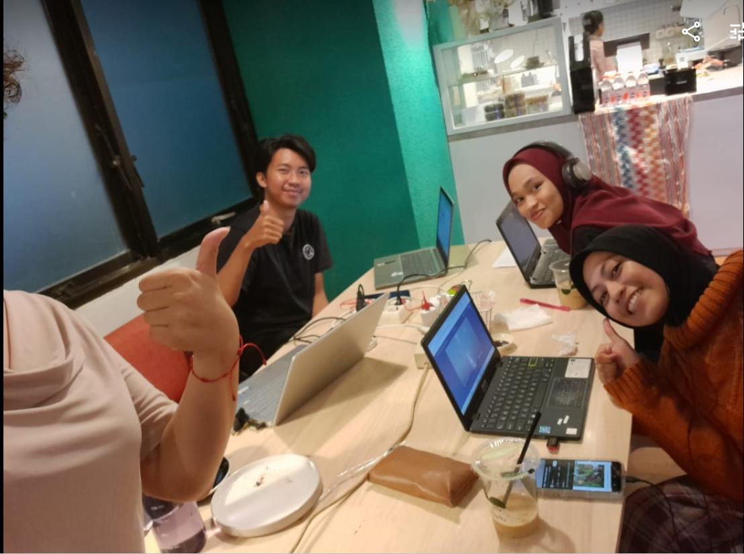
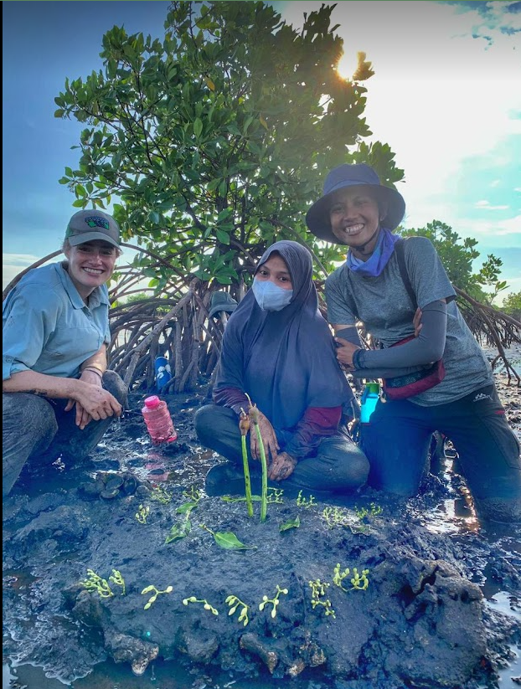

Other activities
Monitoring
Students learning R
Getting to know Tanakeke
Publishing goals – PLOSONE or PeerJ

